Slide 1
Dynamic Scheduling Without Real Time Requirement.
MOHAMMAD ASHRAFUZZAMAN SIDDIQI

Slide 2
What is Scheduling?
Allocation of resources to tasks over time
Goals: Optimize throughput and latency, and ensure fair resource usage.
Type of scheduling
Dynamic Scheduling
Static Scheduling

Slide 3
Static Scheduling
Pre-determined resource allocation
Schedule created at compile time
Used in:
Embedded Systems
Batch Processing Systems
Inflexibility to dynamic changes

Slide 4
Dynamic Scheduling
Dynamic scheduling refers to a process in which tasks and resources are assigned in real-time, either after compilation or during the execution of the system.
Adaptability and real-time decision-making
Greater flexibility and performance
Hardware-based approach
Key Algorithms
Round Robin (RR)
Shortest Remaining Time First (SRTF)
Multilevel Feedback Queue (MLFQ)

Slide 5
Dynamic Scheduling Without Real time Requirements
Dynamic scheduling without a real-time requirement can play an important role in enhancing the overall performance of a computing environment.
When deadlines are of no importance Dynamic scheduling helps to:
Maximized throughputs: Balancing the workload distribution
INCREASES TASK COMPLETION RATE
Optimize Resource Utilization: Optimizes use of CPU, memory, and I/O devices.
Minimizes idle times.
Improve Responsiveness: Prioritizes tasks requiring quick responses.
Enhances user experience.

Slide 6
Dynamic Scheduling Scheduling Algorithms
Round Robin (RR): Preemptive, fixed time quantum for each process.
Shortest Remaining Time First (SRTF): SRTF IS a PREEMTIVE SCHEDULING ALGORITHM
SJF IS NONPREEMTIVE SCHEDULING ALGORITHMS
Multilevel Feedback Queue (MLFQ): MLFQ is a scheduling algorithm that uses multiple queues with different priority levels. Processes can move between queues based on their behavior and CPU burst characteristics.

Slide 7
SJN non preemtive
Process Arrivaltime CPUtime
P1 0 7
P2 2 4
P3 4 1
P4 5 4
p1 | p3 | p2 | p4
0 7 8 12 16
The average waiting time is calculated as: Average waiting time = (0 + 6 + 3 + 7)/4 = 4

Slide 8
PREEMTIVE SCHEDULING ALGORITHM
P1 | P2 | P3 | P2 | P4 | P1
0 2 4 5 7 11 16
Average waiting time = (9 + 1 + 0 + 2)/4 =3
The SRTF algorithm further reduces the average waiting time compared to the non-preemptive SJF algorithm by dynamically selecting the process with the shortest remaining time.

Slide 9
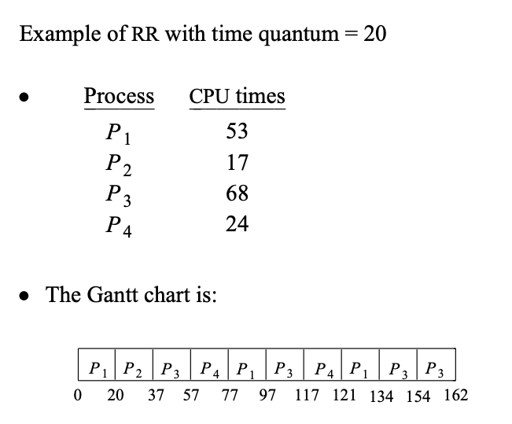
Round Robin (RR)
Round Robin scheduling is a preemptive approach in which each process in the system is assigned a fixed amount of quantum time, often between 10-100 milliseconds.
Cycles through processes, allocating CPU time.
Fairness and simplicity

Slide 10
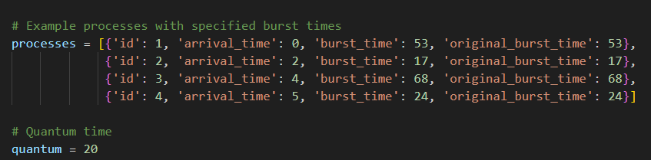

Round Robin (RR) Python Implementation
Initialization of process and queue.
Process sorted by arrival time,
New Processes are dynamically added to the queue
Each process receives the same quantum.
Processes and quantum time definition.
Dynamically Adding to the Queue

Slide 11
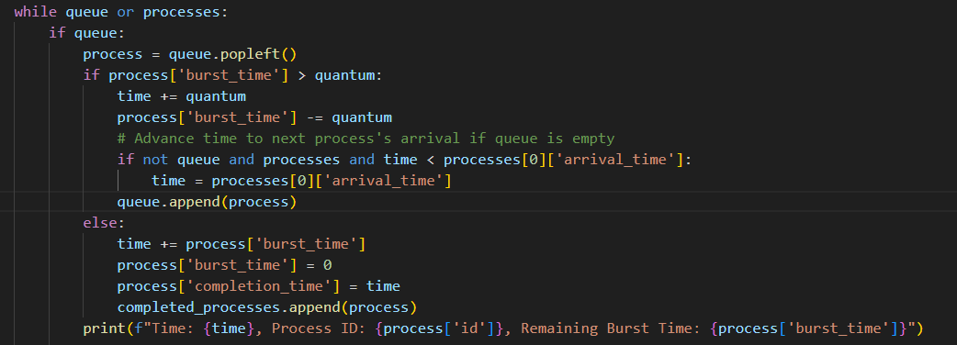
Round Robin (RR) Python Implementation
Completed Processes
If the burst time of a process is greater than the quantum, it's partially processed, and the remaining burst time is updated.
Partially completed processes are added to the back of the queue.
If the burst time of a process is less than or equal to the quantum, the process is completed, and its completion time is recorded.
Processing of Tasks.

Slide 12
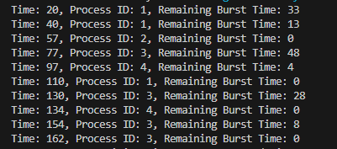
Round Robin (RR)-Python Results
The results Shows Round robin ensures that each process receives a fair share of CPU time without being starved.
The consistent intervals in the results validate that the Round Robin scheduling evenly distributes CPU resources, which helps maintain system responsiveness and performance.

Slide 13
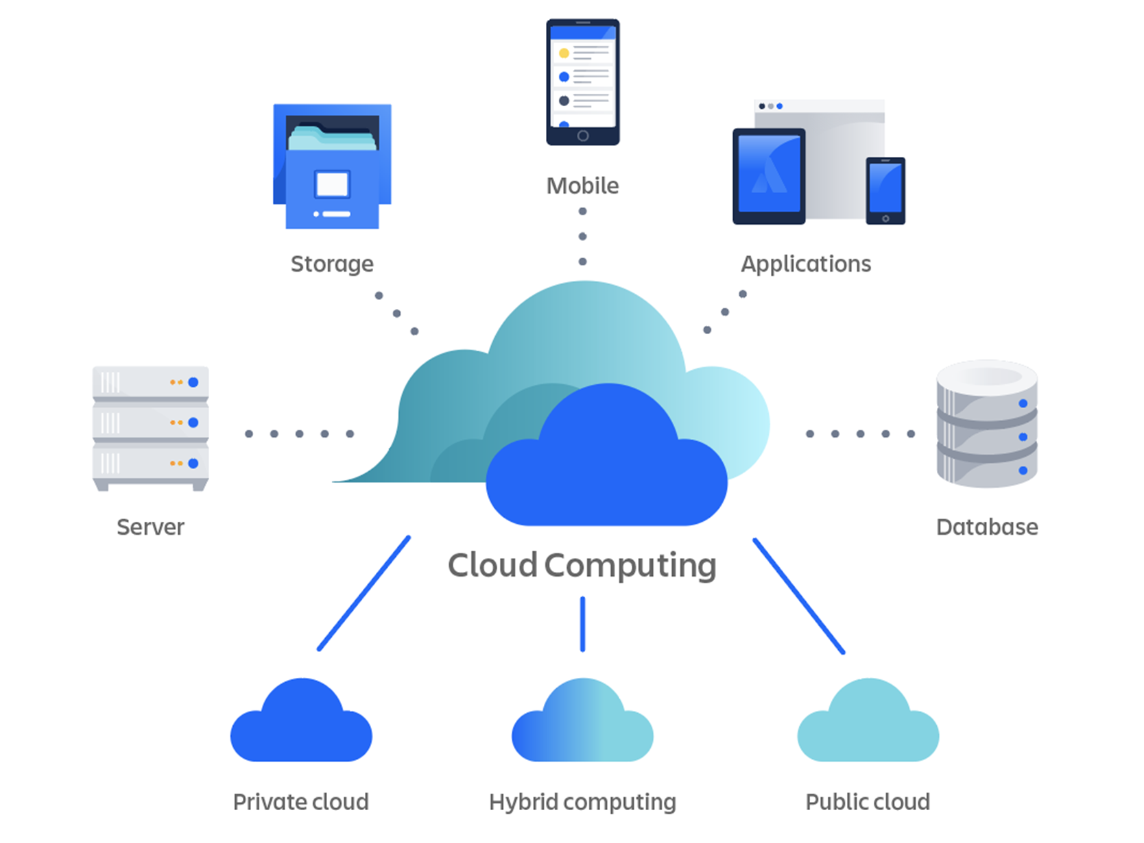
Applications
Cloud Computing
Effective resource management and load balancing.
Dynamic task allocation to virtual machines.
Improved system performance and cost reduction.

Slide 14

Manufacturing Systems
Algorithms adjust task schedules based on current shop floor conditions
Enhances manufacturing efficiency by minimizing downtime.

Slide 15
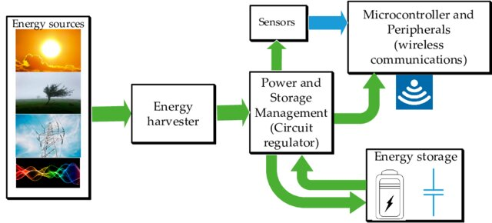
Energy Harvesting Systems
Activates energy harvesting modules as needed.
Balances energy harvesting and consumption for efficiency.

Slide 16
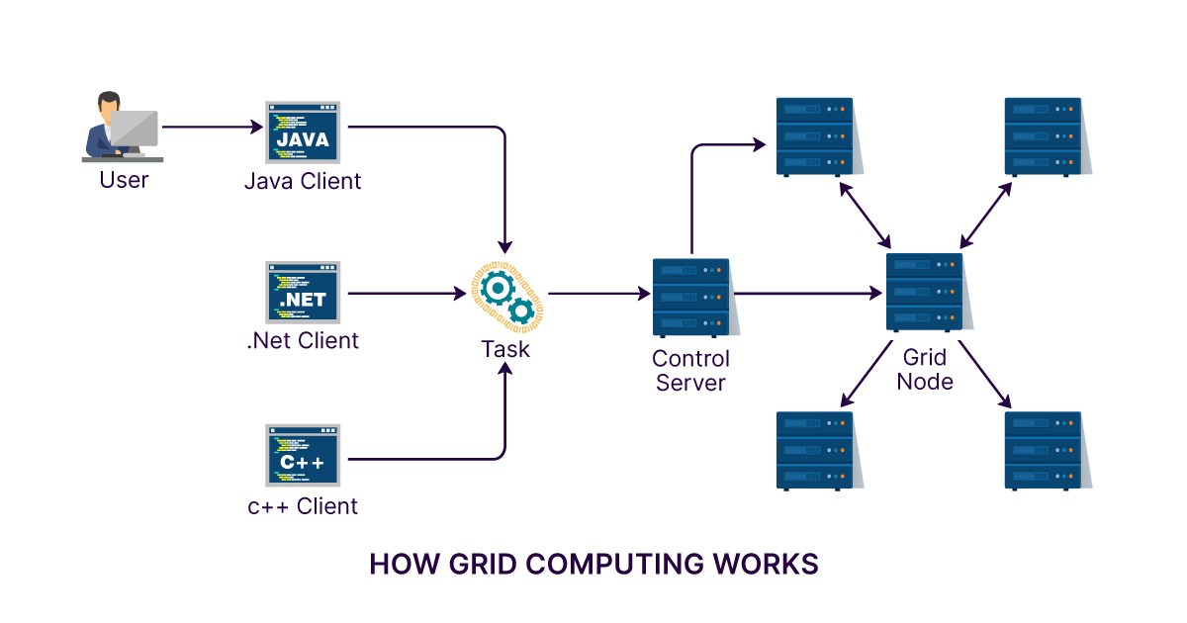
Grid Computing
Prioritizes tasks based on their criticality and resource requirements
Ensures efficient execution and resource utilization.
Optimizes complex scientific computations.

Slide 17
Conclusion
This paper examines dynamic scheduling algorithms, specifically Round Robin (RR) and Shortest Remaining Time First (SRTF), in non-real-time systems. These algorithms significantly improve resource management and efficiency across various applications such as cloud computing, manufacturing, energy harvesting, IoT, and grid computing. By dynamically adapting to workloads and conditions, RR and SRTF ensure optimal performance and cost-effectiveness, demonstrating their critical importance in modern technological environments.

